Slide 1

GA 3331 – Game Prototyping
Week 7
Features + Intensity

Slide 2

Present homework!

Slide 3
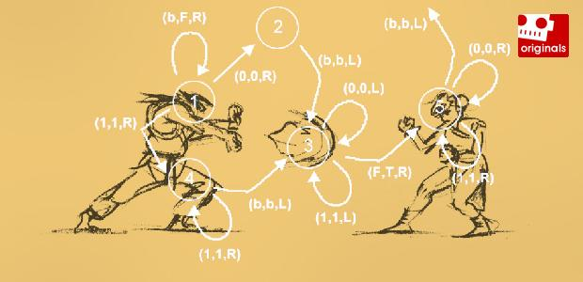
Additive and subtractive design

Slide 4
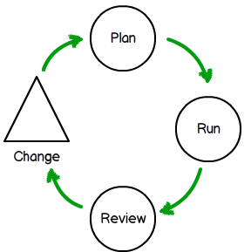
Why Add mechanics?
The game development process is iterative
You can’t know if it’s good or bad until you try it.
Ideally you know about features before production starts.
Notes:
Note, this can be costly
Ideally, you know about all the mechanics before they enter production, but this doesn't always happen thanks to iteration

Slide 5

Why Add mechanics?
Publisher demand (they give you the money)

Slide 6
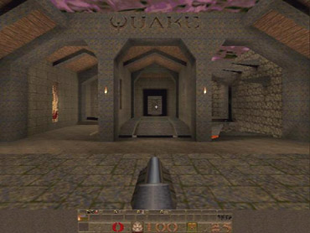
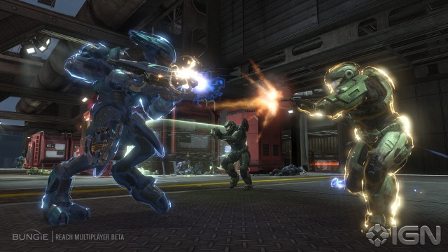
Why Add mechanics?
Changes in the marketplace

Slide 7
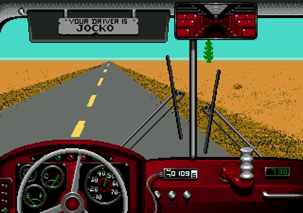
Why Add mechanics?
The game sucks

Slide 8


Why Add mechanics?
You're making a sequel
Notes:
Halo2 - The game features a new game engine, as well as using the Havokphysics engine; added weapons and vehicles, and new multiplayer maps. The player alternately assumes the roles of the human Master Chief and the alien Arbiter in a 26th-century conflict between the human United Nations Space Commandand genocidal Covenant.
After the success of Combat Evolved, a sequel was expected and highly anticipated. Bungie found inspiration in plot points and gameplay elements that had been left out of their first game, including multiplayer over the Internet through Xbox Live.
Halo 3 – Xbox 360 - The game features vehicles, weapons, and gameplay not present in previous titles of the series, as well as the addition of saved gameplay films, file sharing, and the Forge map editor—a utility which allows the player to perform modifications to multiplayer levels.

Slide 9
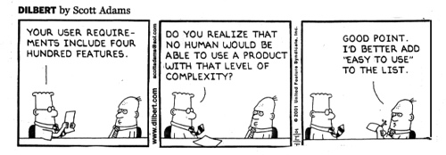
Why Add mechanics?
The brainstorm – AKA feature creep

Slide 10
Why remove mechanics?
The game development process is iterative (déjà vu)
Note: This can be very costly
http://irrationalgames.com/insider/five-cut-features/
“Director’s Cut”
Final Fantasy VII International, Metal Gear Solid: Integral and Rogue Galaxy: Director's Cut
Notes:
Also
Publishers
Market conditions
Fixing bad gameplay

Slide 11


Why remove mechanics?
Ratings/Censorship
Delivering on or in better time

Slide 12

Lab - Challenges
Pick a game that you consider to be terrible. Have another team subtract or add one mechanic that improves it

Slide 13
Lab - Challenges
Take a two player video game and convert it to be playable by four players

Slide 14
Lab - Challenges
Choose an E rated game, and add a mechanic that will bump it to Teen, and Mature

Slide 15
Lab - Challenges
Have another team pick two mechanics (Choose from the list), and add it to your game.

Slide 16
Lab - Challenges
Redesign a game by removing a mechanic (the publisher didn’t want it)

Slide 17


Game intensity
Movies and TV shows relating to good games

Slide 18
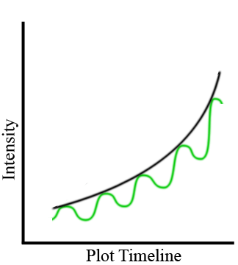
Game intensity
Predicting intensity
Fig. 1: The Green Intensity Curve will produce the greater excitement.
Notes:
To illustrate the benefits of structured intensity and pacing, let's look at an intensity graph. An average intensity graph for a single segment of entertainment (e.g. an episode of a show or a level of a game) would display an ever increasing curve, where the rate of growth is increasing over time (the black arc in Figure 1).
In practice, however, a perfectly arced intensity is impossible to attain since the intensity of entertainment is always fluctuating -- and a perfect curve is even undesirable since it lacks any contrast. Peaks in intensity occur during exciting events, and troughs occur during lull periods lacking in excitement or action. It is in fact the contrast between the two which makes the action super riveting, exciting and satisfying.
Although both graphs in Fig. 1 have the same building intensity overall, the green graph will provide a much more exciting and satisfying experience; the contrast between the peaceful calm and the intense action will punctuate and maximize the impact of the events.
In the green graph of Fig. 1 above, the intensity is the excitement magnitude of the event and the pacing is the frequency between similarly intense events (peak to peak or trough to trough).
In the real entertainment world, the term "pacing" is often used in a broader sense that encompasses both the rhythm of events and the magnitude of intensity, so we will follow that convention moving forward -- except where we specifically indicate the intensity component separate from the time and distance pacing.

Slide 19
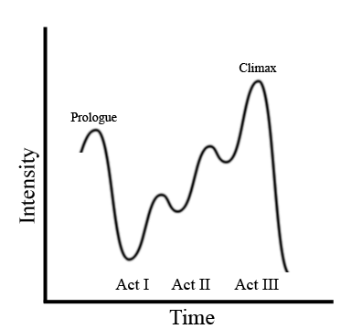
Game intensity
Movie Structure
Fig. 2: A Blockbuster Intensity Graph
Notes:
Any movie review which proclaims the experience is "a rollercoaster ride" is usually a good indication that the intensity and pacing are well structured and executed in the film.
So, how exactly does Hollywood structure the intensity and pacing for a blockbuster film? Simple -- they plan out a relative intensity graph which shows an initial spike, then a wave with incrementally increasing peaks and troughs.
Next they come up with the key action or excitement scenes which they order in terms of the magnitude of impact. Usually, they set these events to occur around the transition from one act to another; this event sequencing fits within the three-act structure (Figure 2) that includes a setup act (optionally preceded by a prologue), a confrontation act, and a final resolution act.

Slide 20
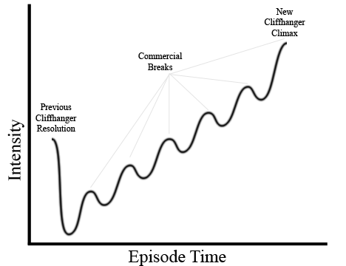
Game intensity
TV Structure
Fig. 3: Intensity Graph for an episode of a TV drama (note the increase in intensity peaks)
Notes:
Similar to their movie counterparts, the creative teams behind 24, Prison Break and Lost plan multiple action events into each 42 minute episode. They also sequence these events based on their own deliberate intensity ranking, in order to control the order of events and therefore the pacing and intensity of the episode.
They control the intensity based on the magnitude of impact and the ranked order of the action events. They control the pacing based on the duration between action, creating a rhythm to the events.
For a typical episode, they place one of the more exciting events at the front (often a resolution to the cliff-hanger from the previous episode) and the most exciting event or plot twist at the end to serve as a climactic cliff-hanger. So, an intensity graph for a single episode may look something like a sine wave with an initial spike and drop and then an ever-increasing amplitude (Figure 3).

Slide 21
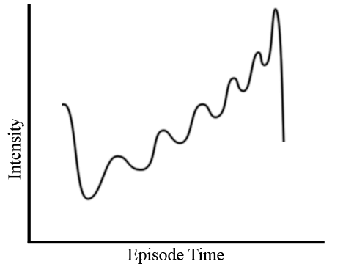
Game intensity
TV Structure
Fig. 4: Increasing Episode Pacing & Intensity
Notes:
Since television is advertising-driven, these dramas tend to utilize multiple intensity spikes as mini cliff-hangers and insert a commercial point in order to keep as many live viewers as possible riveted to their seats during the break (allowing them to charge more for their commercials).
The creative team may also sequence the events together in shorter and shorter duration within an episode in order to increase the pace of excitement along with the magnitude of the intensity (Fig. 4 -- with increasingly shorter/faster frequency and taller amplitude).
With or without duration changes, the result of their pacing and intensity structure is an amazing roller-coaster ride of an episode that keeps viewers riveted to their seats each week (and keeps the advertisers forking over top dollars).
If the magic behind the intensity and pacing for a single episode of 24, Lost, or Prison Break is impressive, then the continual increase over the entire season is sheer unadulterated genius, and the results are simply spectacular; many would argue the first few seasons of these series demonstrate the best in TV drama history.

Slide 22
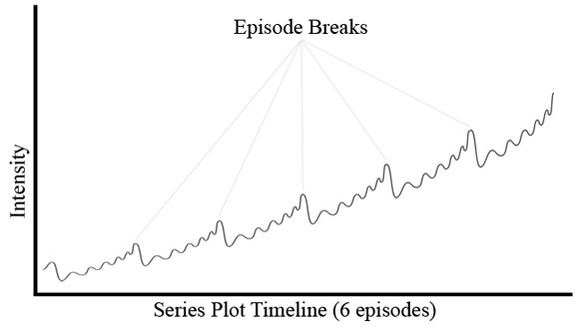
Game intensity
TV Structure
Fig. 5: Relative Intensity Graph of a TV Drama Series (Amplitude Increasing for Greatest Contrast)
Notes:
From episode to episode, the creative team may also sequence the events together in shorter and shorter duration and ending at a shorter extreme than the previous episode (Fig. 5) to increase the pace of excitement along with the intensity, making each episode feel more hectic and rushed than the one before.
The team behind Prison Break was particularly good at delivering this in Season 1, but pace increases have not been so noticeable in latter seasons (perhaps because it made the initial pilot episodes feel a bit slow).
With or without the increasing pace, the result of the well-executed pacing and intensity plan is a season progression which is ultimately engaging, satisfying, and market successful. This structure is the TV equivalent of a campaign structure that designers should strive to achieve.

Slide 23
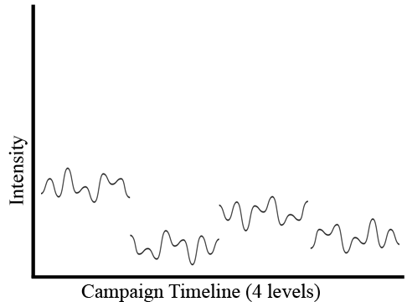
Game intensity
Game structure
Fig. 6: Lack of Structure = Arbitrary Career Experience
Notes:
A modern game team who relies on the mechanics and game systems or A.I. alone to control the pacing outcome will fall far short of the pacing and intensity of the top games, TV shows, or movies.
Those not carefully planning will produce a more arbitrary and flat sine wave of intensity without any predictable and desirable patterns of action. The rhythm of such a game will become fairly predictable, and these games will soon begin to bore players.
For a game level, mission, or course, an unplanned / on-the-fly construction process will always deliver a series of events without any predictable pattern of pacing or intensity within the game level. The opportunity to deliver the most high-octane experience will be lost (Figure 6).

Slide 24
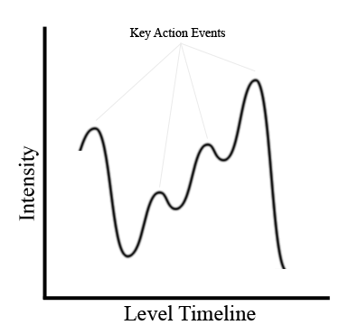
Game intensity
Game structure
Fig. 7: Structured Level Content Dictates Pacing (the mission starts between the first peak and trough)
Notes:
The system-driven and environment-constructed events will still occur and create intensity peaks and troughs, but the height of the peaks will vary erratically and the duration between the events will be unpredictable. So, any beneficial rhythm of pacing/intensity will be lost, as likely will the player's attention.
To create a heart-racing, nail biting, roller-coaster ride of excitement in a game, we need to first organize a level plan with a carefully structured series of events, prior to the construction of the level, mission or course (i.e. during pre-production).
It is not necessary that all or even most of the micro elements be planned out into an über-detailed design at this stage, although some teams prefer to do so by early production and there are many merits there. What is most important is that the key gameplay, action, and story plot events are ranked, ordered and spaced out to create an experience that is continually increasing in intensity (the peaks of the graph), and either consistent or increasing in pace (Fig. 7 shows a consistent pace).

Slide 25
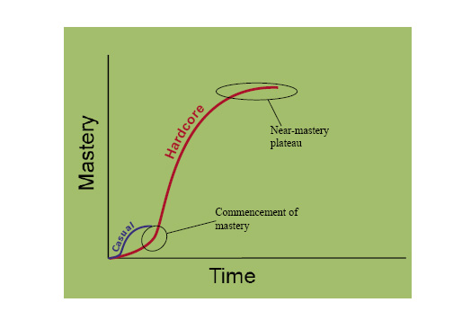
The Learning Curve
Casual games
The skill ceiling for mastery – Casual vs Hardcore
Notes:
The central tenet of conventional videogame design is that a game should get more difficult in sync with the player, as he or she learns and becomes more skilled. In most games, the last level is harder than the first level. In most games the end requires more skills and better skills than the beginning. For the most part this is true in both hardcore games and casual games, although hardcore games follow that pattern more strictly.
The general trend with hardcore games is that the skills they have to teach require a lot of investment in terms of time and energy. Hardcore games need to be played in longer sessions because it’s hard to acquire mastery of a complex set of skills by practicing in bursts of ten minutes or less. There are too many factors; there is too much to learn. In hardcore games playing 30-90 minutes per session is fairly normal. The fact that these games take a long time to master also explains why hardcore gamers don’t always seem to be having fun while they’re playing. A hardcore gamer will patiently play a frustrating game for hours because they know that the highest level of enjoyment will come later. Hardcore games also tend to have more total time per title because once the player masters deep skills, they want to use those skills for a proportionately long while or there’s no “payoff.”
Casual games, on the other hand, don’t always require a large investment in time and energy. It is possible to play many casual games for short bursts, and often it is possible to complete whole games in fifteen minutes to an hour. The obvious conclusion to draw here is that casual games usually teach and use skills whose ceiling for mastery is much lower than their hardcore counterparts. We can visualize this discrepancy on a graph

Slide 26
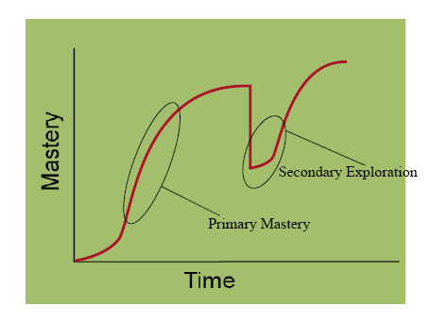
The Learning Curve
Casual games
Offering multiple areas to master in a game
Notes:
This is a hardcore learning curve in the presence of multiple skill sets of equal viability. Initially the player explores the various characters, factions, weapons, etc until they find one that they like; this is the assessment period. I call it assessment because the player is actively searching for something to master, rather than exploring the game’s features for the self-conscious sake of fun. The next period is the mastery of the selected skill-set. We can call this period “primary mastery” as it is the first major investment by the player.Toward the end of primary mastery most hardcore players will experience diminishing returns in effort, highlighted on both graphs. As it is with any skill from karate to playing the piano, the closer you are to complete mastery, the harder it is to make noticeable further progress. Because the last 10% or so of a game’s skill-set is the hardest to master, players will often take a break. In games where there are multiple skill-sets of equal value to master, players can take a break from primary mastery while still playing the same game. For example:

Slide 27
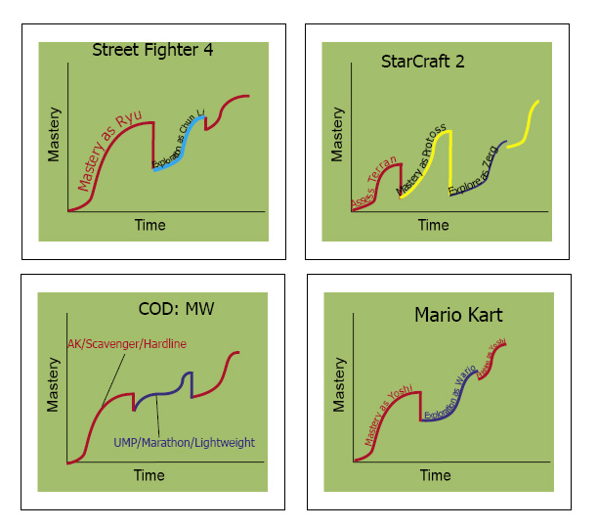
The Learning Curve
Mastery and Exploration
Street fighter 4
Starcraft 2
COD: MW
Mario kart
Notes:
In a well-designed game, exploring some the other skill sets can actually help a player achieve the final bit of mastery in the primary one. The player who switches from Ryu to Chung-Li in Street Fighter 4 learns (incidentally) how to maximize their zone game and comes back to Ryu with the necessary insight and composure to finish mastering that character. The player who switches from protoss to zerg in StarCraft 2 learns how to not rely on a single type of high-tech unit when attacking, and returns to protoss with a more flexible strategy. The player who has been racing as Yoshi in Mario Kart for a long time switches to Wario for variety, and learns to plan ahead on the race course so they can take corners more aggressively.
This period, where the player has discontinued their initial mastery of one set of skills can be called the meditation period. There is a strong likelihood that the player will return to the skills they honed during primary mastery, even if they don’t explore other skills; some time away from the game will help them get back to their mastery with greater enthusiasm and energy. But as discussed above, many players take this opportunity to learn a new character, faction or strategy in the same game since they’ve learned the basic skills of the game and enjoy playing it. When the player goes from focused mastery into a late survey of other options in the game, we can call it secondary exploration. Exploration of the game wasn’t their first goal, mastery was; but broader exploration became a valuable (and fun) pursuit because it helped them finish primary mastery.

Slide 28
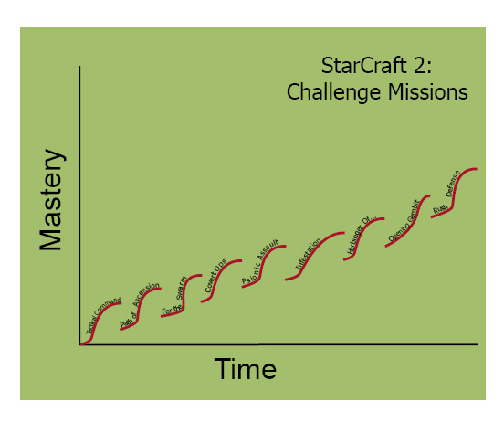
The Learning Curve
SC2 Single Player
Challenges
Notes:
There’s an interesting twist to game design in the study of mastery and exploration that acts as the bridge between hardcore games and casual games. One of the games graphed above, StarCraft 2, has two different kinds of learning curves. The first one is the primary mastery discussed already, but the second learning curve is one the designers cleverly built into the game: primary exploration. Although competitive multiplayer is the arena in which most StarCraft players achieve mastery, the designers built in an alternative that covers much of the same development of skills. One of the single-player options is the “challenge” missions, which are designed to build just a few specific skills each. Essentially each challenge acts as a much smaller mastery curve. (Although it’s still most definitely a hardcore game, every minute of the way.)

Slide 29
Fulfillment and Rewards
http://www.gamasutra.com/blogs/MickeyBlumental/20130131/185858/10_Ways_to_Retain_Your_Players.php
http://www.gamasutra.com/view/feature/134246/reward_systems_an_excerpt_from_.php?print=1
http://www.gamasutra.com/view/feature/3085/behavioral_game_design.php

Slide 30

The “Farmville” effect
http://www.gamasutra.com/blogs/MarkNewheiser/20091204/3733/Farmville_Social_Gaming_and_Addiction.php

Slide 31

Lab – Capture the flag
Lab – Modding capture the flag

